Slide 1

Buying & selling for a good cause
properties for a socially responsible investor
a proposal by real estate data analysts MJR & TD
september 2025

Slide 2

Our client erin robinson
investing in poor neighborhoods
buying & selling
covering costs
small profit
socially responsible
QUESTIONS
what are good types of properties for erin to invest in? to what extent do prices, property’s condition and season for buying/selling matter for erin’s socially responsible purposes?
AI-created photo

Slide 3
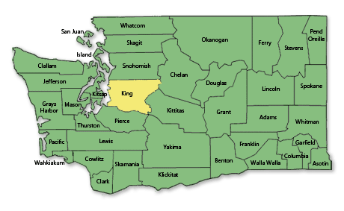
data
DATA SET
king county house details & king county house sales datasets merged
21.420 properties listed
covering 05/2014-05/2015
property prices range $78K-7.7M
20 original parameters
PARAMETERS used
date sold, date built, price, coordinates, condition

Slide 4
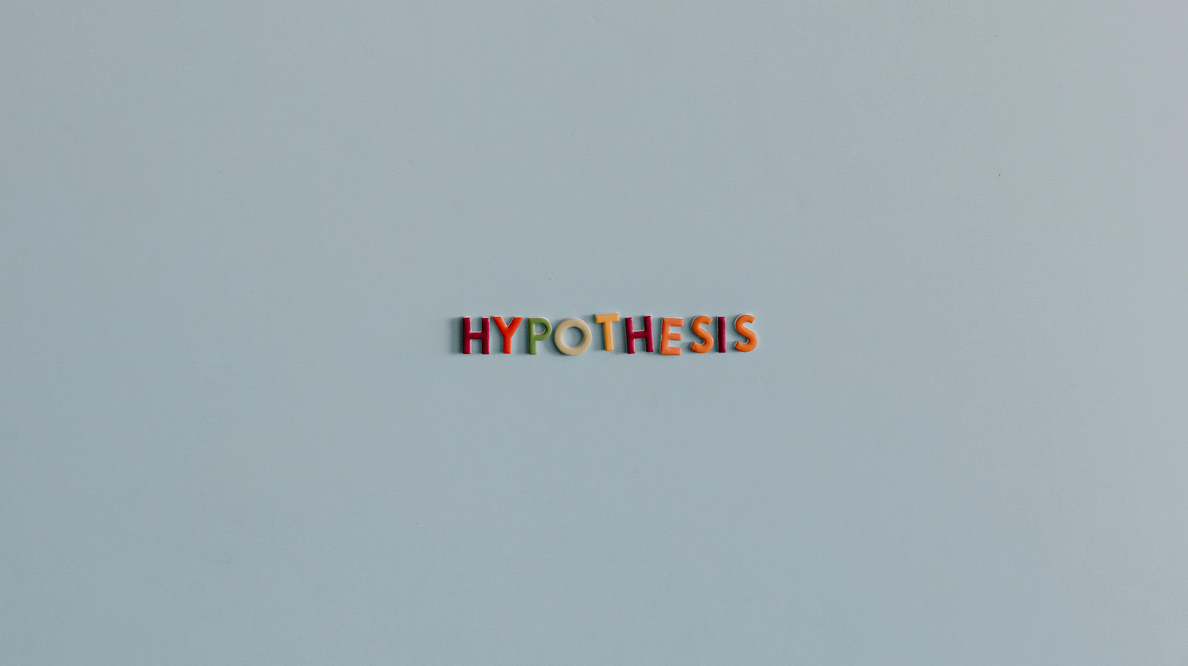
H1: properties sold below median price are located further away from the city center
H2: properties built before 1990 and in poor condition have a 10% lower median price compared to other properties
H3: properties sold during the winter season have a median price at least 10% lower compared to other properties

Slide 5
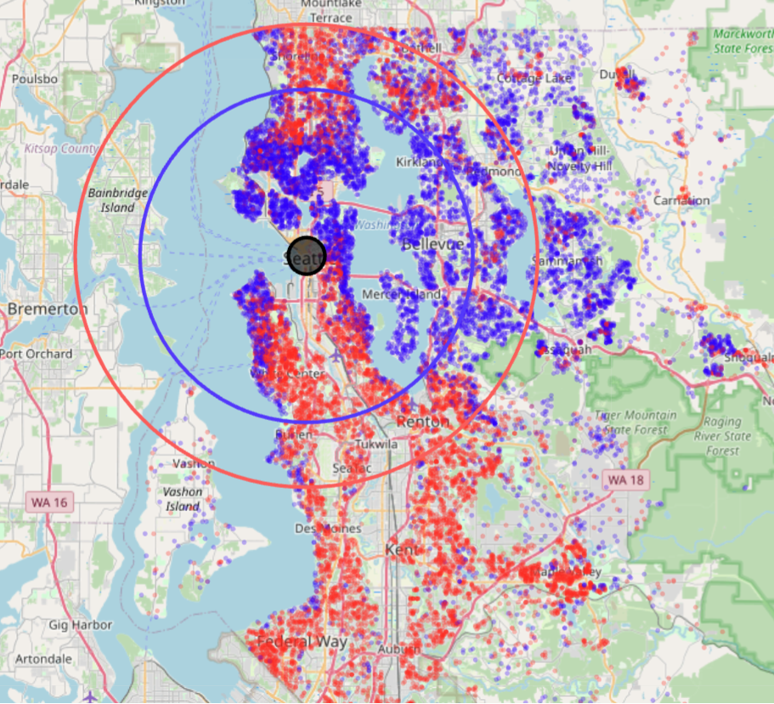
Distance to city center
FINDING
properties sold below median price (red dots) are typically 19.5 km away from city center (red circle)
properties sold above median price (blue dots) are typically 14 km away from city center (blue circle)
property price decreases as we move away from city center (r = -0.28, indicating weak correlation)
RECOMMENDATION
inconclusive - further analysis needed to investigate whether distance makes a significant difference at all

Slide 6
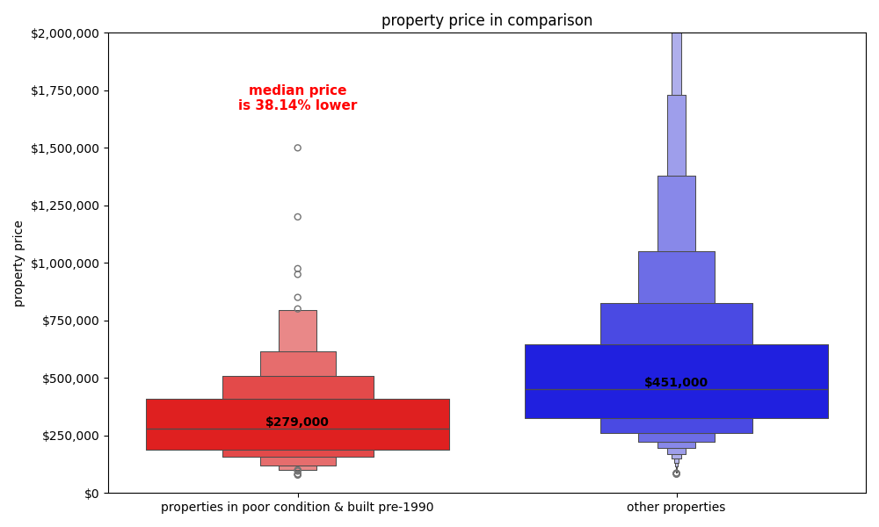
Properties in poor condition
FINDING
typical price for properties in poor condition and built pre-1990 cost below 300K
properties built pre-1990 and in poor condition are 38% lower in price than other properties
construction year not significant in this context (same results for properties in poor condition only)
RECOMMENDATION
properties in poor condition regardless of construction year are suitable for socially responsible investment

Slide 7
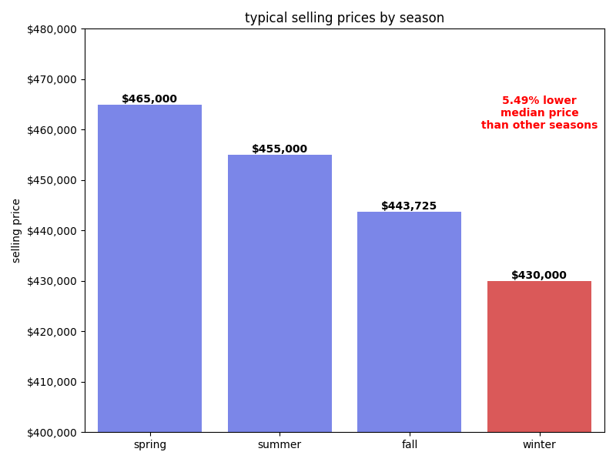
Winter season
FINDING
typical selling price for properties lowest in winter, highest in spring
selling price for properties is 5.5% lower in winter than in other seasons
RECOMMENDATION
buying properties in winter recommended
selling properties in winter gives lower-income buyers an opportunity to buy
for small profit, consider selling in fall

Slide 8
Recommendations for a socially responsible investment
roadmap
buy properties in poor condition
buy properties in winter
sell properties in winter / fall
distance to city center secondary

